Slide 1
COVID-19 Vaccinations Trend Analysis
CASE STUDY
By:
Nitish Ram

Slide 2
AIM:
COVID-19 Vaccinations Trend Analysis

Slide 3
INTRODUCTION:
Analysing and visualizing the latest situation of “Covid19 Vaccination“ around the world. We will use POWER BI for data visualization & for data analysis.

Slide 4
PROBLEM STSTEMENT:
Analysis preparation
What vaccines are used in each country?
Which vaccines used most?
How many are vaccinated?
How the vaccination progressed

Slide 5
METHODOLOGY:
Analysing and visualizing the latest situation of “Covid19 Vaccination“ around the world. We will use POWER BI for data visualization & for data analysis.
Data collecting method:
We imported the data into POWER BI.
Removed NULL values.

Slide 6
Columns in dataset:
Country
ISO Code
Date
Total number of vaccinations
People vaccinated
People fully vaccinated ;
Daily vaccinations (raw)
Daily vaccinations
Total vaccinations per hundred
People vaccinated per hundred
People fully vaccinated per hundred
Number of vaccinations per day
Daily vaccinations per million
Vaccines used in the country
Source
Source website

Slide 7
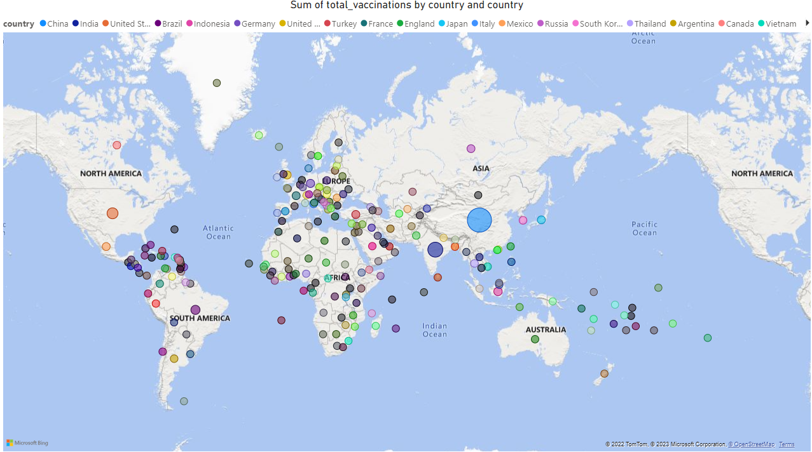
ANALYSIS:
Total vaccinations by country:

Slide 8
﻿China accounted for 35.42% of Sum of total_vaccinations.
﻿Across all 223 country, Sum of total_vaccinations ranged from 348 to 709452663700.

Slide 9
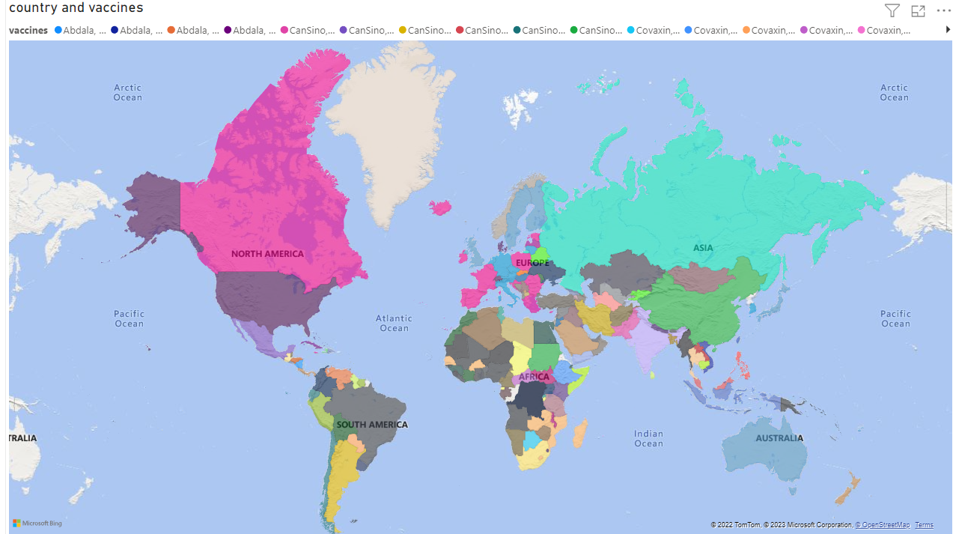
Country and vaccines:

Slide 10
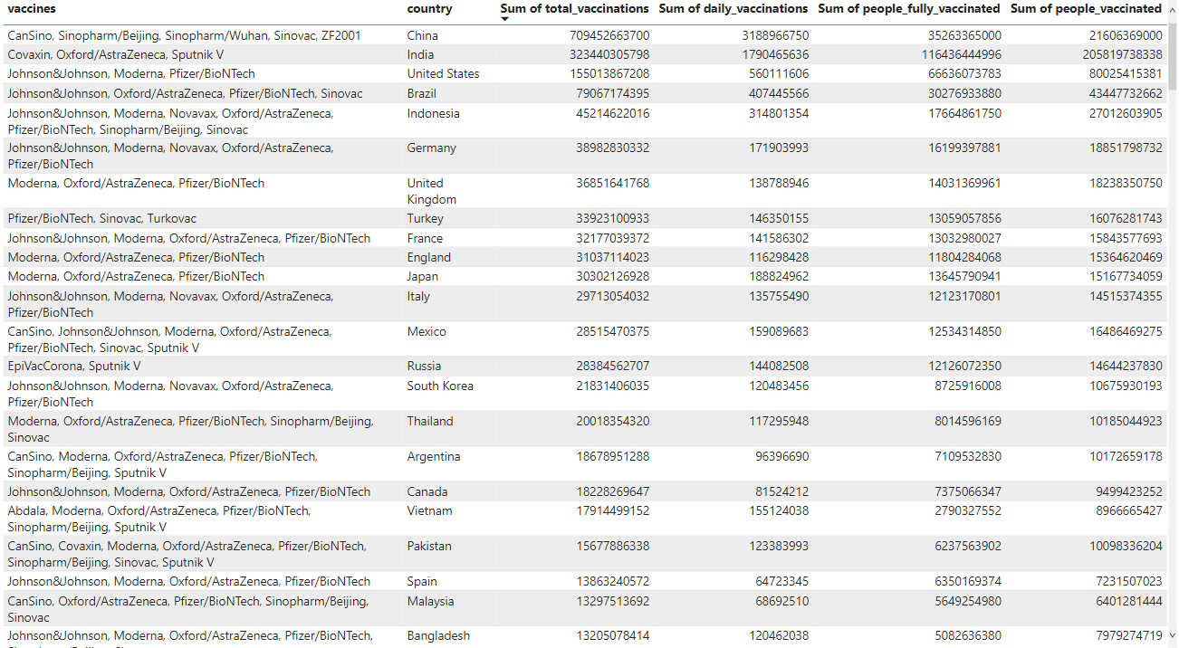

Slide 11
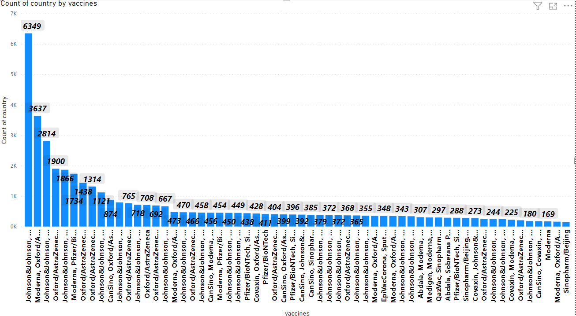
Which vaccines used most?
Johnson&Johnson, Moderna, Oxford/AstraZeneca, Pfizer/Bio NTech had the highest Count of country at 6,349, followed by Moderna, Oxford/AstraZeneca, Pfizer/Bio NTech and Johnson&Johnson, Moderna, Novavax, Oxford/AstraZeneca, Pfizer/Bio NTech. EpiVacCorona, Oxford/AstraZeneca, QazVac, Sinopharm/Beijing, Sputnik V, ZF2001 had the lowest Count of country at 3.
﻿Across all 84 vaccines, Count of country ranged from 3 to 6,349.

Slide 12
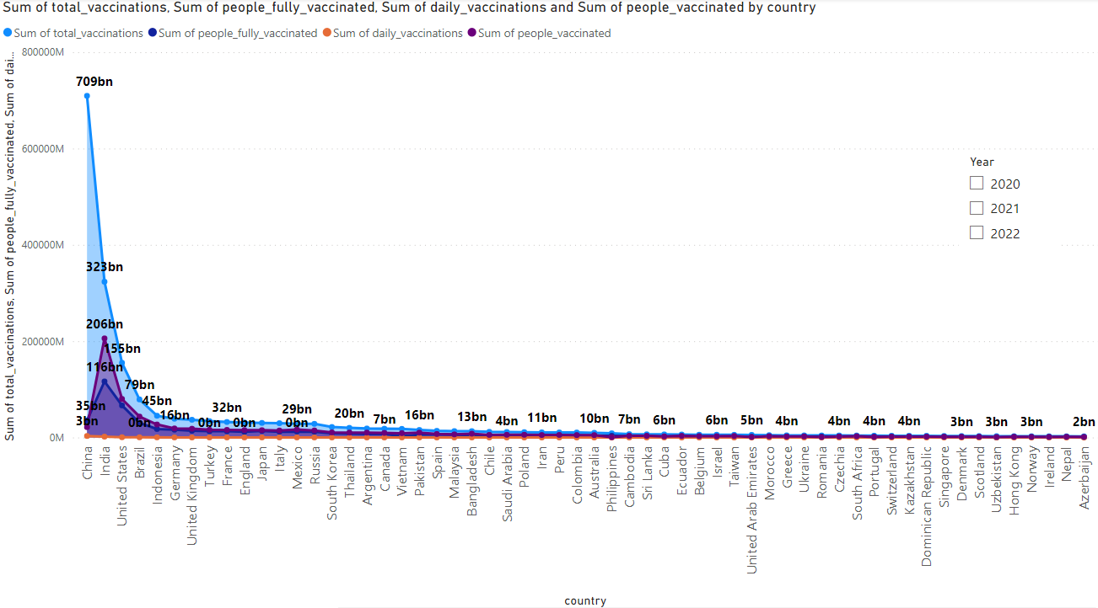
Vaccination of country by years:
Across all 223 country, Sum of total_vaccinations ranged from 348 to 709452663700, Sum of people_fully_vaccinated ranged from 113 to 116436444996, and Sum of daily_vaccinations ranged from 2 to 3188966750

Slide 13
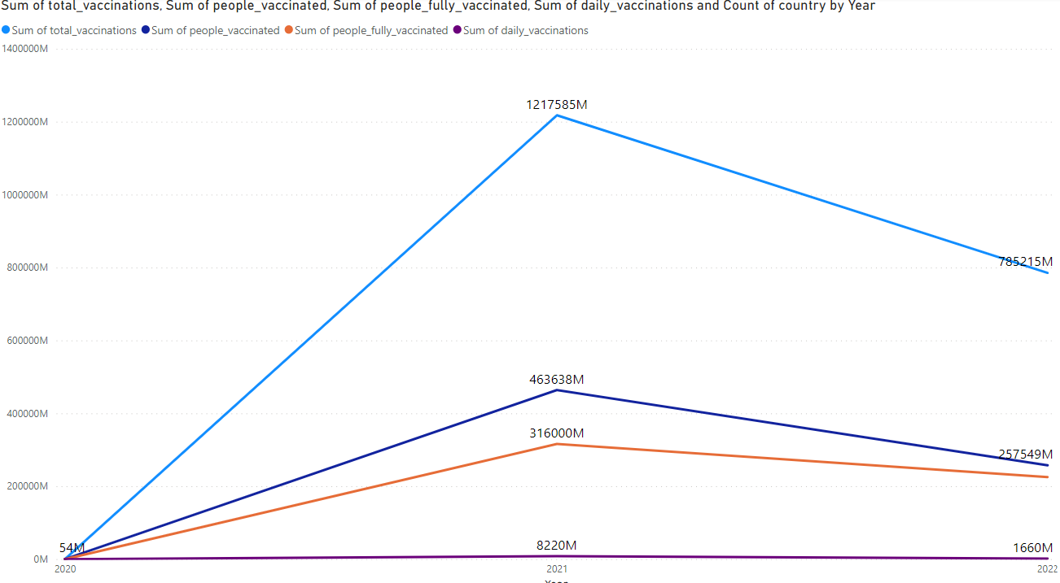
Vaccination by year:
Sum of people_fully_vaccinated jumped from 321734 to 225270572442 during its steepest incline between 2020 and 2022.

Slide 14
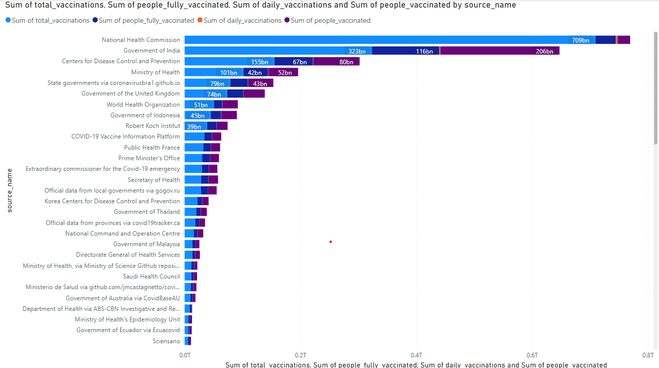
Vaccinations by country:
Across all 81 source_name, Sum of total_vaccinations ranged from 14163 to 709452663700, Sum of people_fully_vaccinated ranged from 3492 to 116436444996, and Sum of daily_vaccinations ranged from 424 to 3188966750.

Slide 15
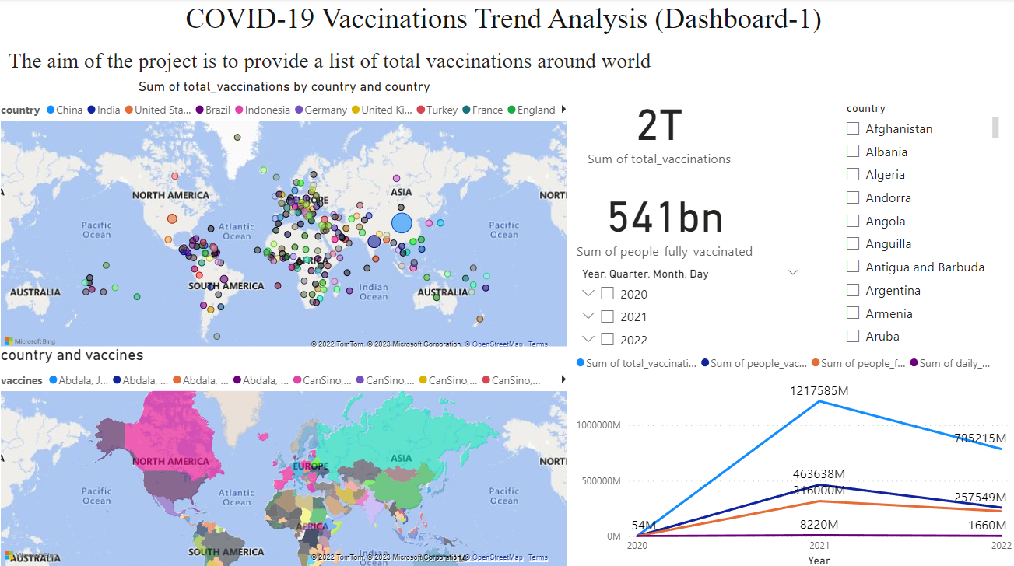

Slide 16
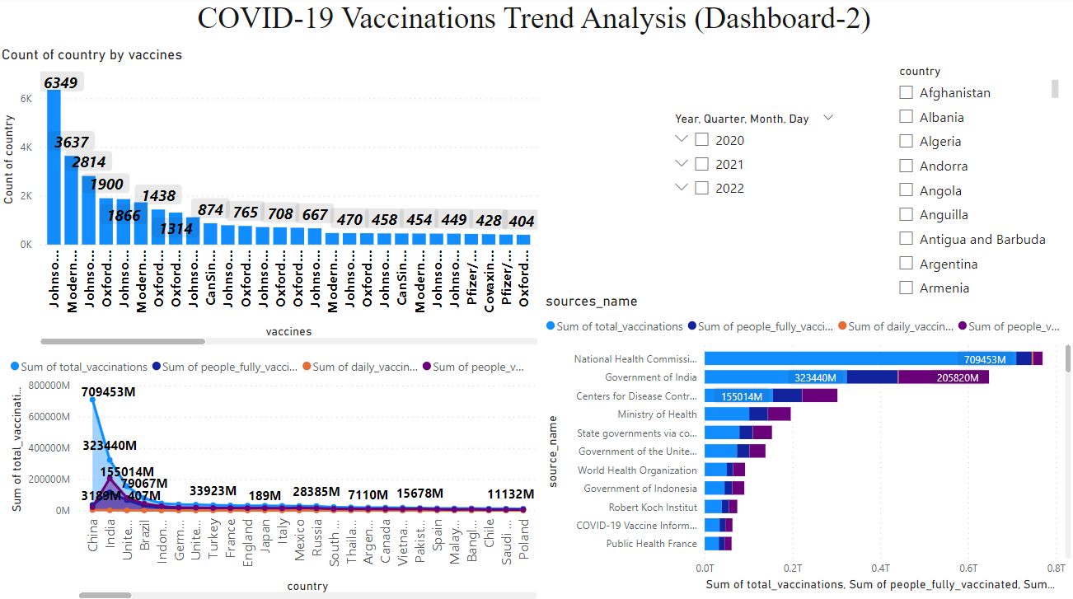

Slide 17
INSIGHTS:
total_vaccinations, people_fully_vaccinated, daily_vaccinations, people_vaccinated are mainly used for the analyse the dataset.

Slide 18
CONCLUSION:
China, India, United States has highest rate of vaccinations according to the data.
Johnson&Johnson, Moderna, Oxford/AstraZeneca, Pfizer/Bio NTech had the highest Count of country at 6,349, followed by Moderna, Oxford/AstraZeneca, Pfizer/Bio NTech and Johnson&Johnson, Moderna, Novavax.
According to the data the Vaccinations increased from 2020 to 2021,And decreased from 2021 to 2022 by this we can assume that the COVID-19 cases are reduced.

